Slide 1
Shell continued; Computing on a Cluster; Using Github
Lecture 4

Slide 2
Recall that last class we learned basic commands to use in Bash (aka Shell / Terminal)
pwd
.
ls
nano/vim
mkdir
cd
cp
mv
man
echo / printf
more
less
head
rm** CAREFUL!
Recursive commands
rm –r ** VERY DANGEROUS!

Slide 3
Piping

Slide 4
Piping
The Pipe is a command in Linux that lets you use two or more commands such that output of one command serves as input to the next.
output of each process is direct input to next one
Like a pipeline
The symbol '|' denotes a pipe.
printf "welcome to BME590 \nwe love it here \nit is better than BME590.88" | sed 's/BME590/BME590.12/' | grep "we"
Notes:
Above line:
1st line: prints a message
2nd line: sed: find and replace BME590 with BME590.88
3rd line: only runs lines that start with “we” (searches)

Slide 5
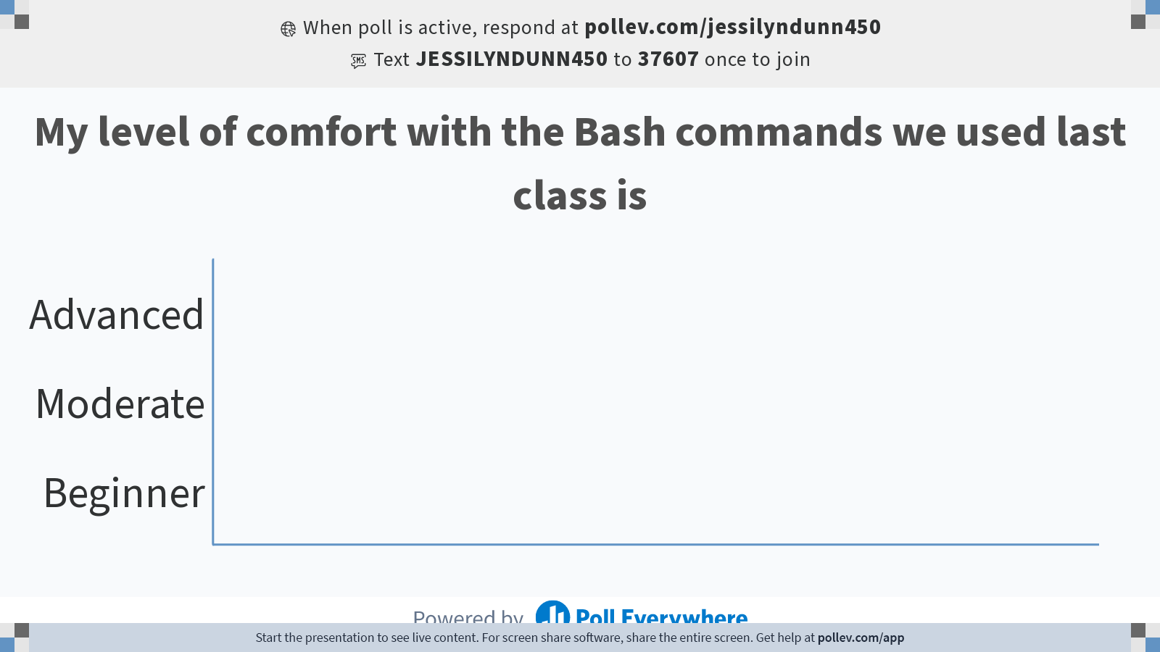
Notes:
Do not modify the notes in this section to avoid tampering with the Poll Everywhere activity. More info at polleverywhere.com/support My level of comfort with the Bash commands we used last class is
https://www.polleverywhere.com/multiple_choice_polls/td5LMHqhNb884MJuXLR0s?state=opened&flow=Default&onscreen=persist

Slide 6
Today we will dive into the details of useful commands in data science
awk – processing text
tr
grep – pattern searching (RegEx)
sed – stream editor
wc
sort
cut
uniq
Regex & wildcards (*)
https://medium.com/@kadek/command-line-tricks-for-data-scientists-c98e0abe5da

Slide 7
AWK
a utility that is mostly used for pattern scanning and processing.
searches one or more files to see if they contain lines that matches with the specified patterns and then performs the associated actions.
enables a programmer to write tiny but effective programs
define text patterns that are to be searched for in each line of a document and the action that is to be taken when a match is found within a line.
Fun fact: the name is a combination of the first letters of the last names of the 3 developers of Awk
http://www.grymoire.com/Unix/Awk.html
https://www.geeksforgeeks.org/awk-command-unixlinux-examples/
Notes:
Does 2 things: looks for pattern and does something to it

Slide 8
What Can We Do With Awk?
AWK Operations
Scans a file line by line
Splits each input line into fields
Compares input line/fields to pattern
Performs action(s) on matched lines
Awk’s built-in variables include the field variables—$1, $2, $3, and so on ($0 is the entire line) — that break a line of text into individual words or pieces called fields.
http://linuxcommand.org/lc3_adv_awk.php
https://www.geeksforgeeks.org/awk-command-unixlinux-examples/

Slide 9
Try searching online how to use Awk to…
Find out how many columns there are in the file smartwatch_data.csv?
Look at rows where the type of activity is running
Find out how many rows there are where the type of activity is running?
Print only the type of activity and the HR
Notes:
wc –l smartwatch_data.csv : count lines: use this!!!
awk ‘END { print NR }’ : counts lines but one off (counts headers, don’t use)
awk -F',' '{ print NF; exit }' smartwatch_data.csv
- print the number of fields and then exit. –F’,’ means comma-delimited.
cat: pull all data into memory
3.
awk '/run/ {print}' smartwatch_data.csv: finds /run/ keyword and prints
awk -F',' '{ if($1 == "run") print $0;}' smartwatch_data.csv: delimit via comma, if the first field contains run, print all fields in that row
awk '/run/ {print}' smartwatch_data.csv | wc –l: how many lines are run activities?
$NF: last field
awk –F’,’ vs cut –d’,’: same thing
cat smartwatch_data.csv | cut -d',' -f2: show all lines in the second field
awk 'BEGIN { FS = "," } ; { print $2 }' smartwatch_data.csv: show all lines in the second field
awk: BEGIN or END: where we start in the program

Slide 10
Tr
A utility that is mostly used for basic file cleaning.
An ideal use case is for swapping out the delimiters within a file (e.g., converting a tab delimited file into a .csv file)
Tr stands for “translate”
Notes:
basic search and replace

Slide 11
Try searching online how to use tr to…
5. Replace the commas with tabs in smartwatch_data.csv; print this output to a new file called tab_delimited_smartwatch_data
6. Replace the commas with asterisks in smartwatch_data.csv; print this output to a new file called asterisk_delimited_smartwatch_data.csv
Notes:
cat smartwatch_data.csv | tr "," "\\t" > tab_delimited.csv. # print output to a new file
> : use to write output to a file instead of printing in the terminal.

Slide 12
Regular Expressions
aka Regex
a sequence of characters that define a search pattern.
Usually such patterns are used by string searching algorithms for "find" or "find and replace" operations on strings, or for input validation.

Slide 13
(?<=\.) {2,}(?=[A-Z])
At least two spaces are matched, but only if they occur directly after a period (.) and before an uppercase letter.
Notes:
\ is the escape tool to represent certain characters that have other meanings in Regex
The sequence matched by the regex is:
(?<=\.) Indicates matching a period before, but not as a part of, the match (FYI, this is called a “positive lookahead zero-length assertion”)
{2,} indicates two spaces
(?=[A-Z]) Indicates matching a capital letter after, but not as a part of, the match (this is another example of a “positive lookahead zero-length assertion”)

Slide 14
Try searching online how to use RegEx to…
7. Replace all of the lower case letters with capital letters in the smartwatch_data.csv file
Note: Here is a nice tool to test out your Regex code and try to understand what it is doing: https://regex101.com/

Slide 15
Grep
Global search for a regular expression and print, or grep; likely, the most well known command, and with good reason. Grep has a lot of power, especially for finding your way around large codebases. Within the realm of data science, it acts as a refining mechanism for other commands. Although its standard usage is valuable as well.
Count total number of lines containing word / pattern.
https://www.geeksforgeeks.org/grep-command-in-unixlinux/

Slide 16
Try searching online how to use grep to…
8. Use grep to look at the rows where the type of activity is running
9. Use grep to look at all measurements from a specific date (e.g., 6/7/26)
Notes:
grep has really simple syntax…easy alternative to awk
doesn’t specify field of search query
8. grep run smartwatch_data.csv
9. grep 6/7/26 smartwatch_data.csv

Slide 17
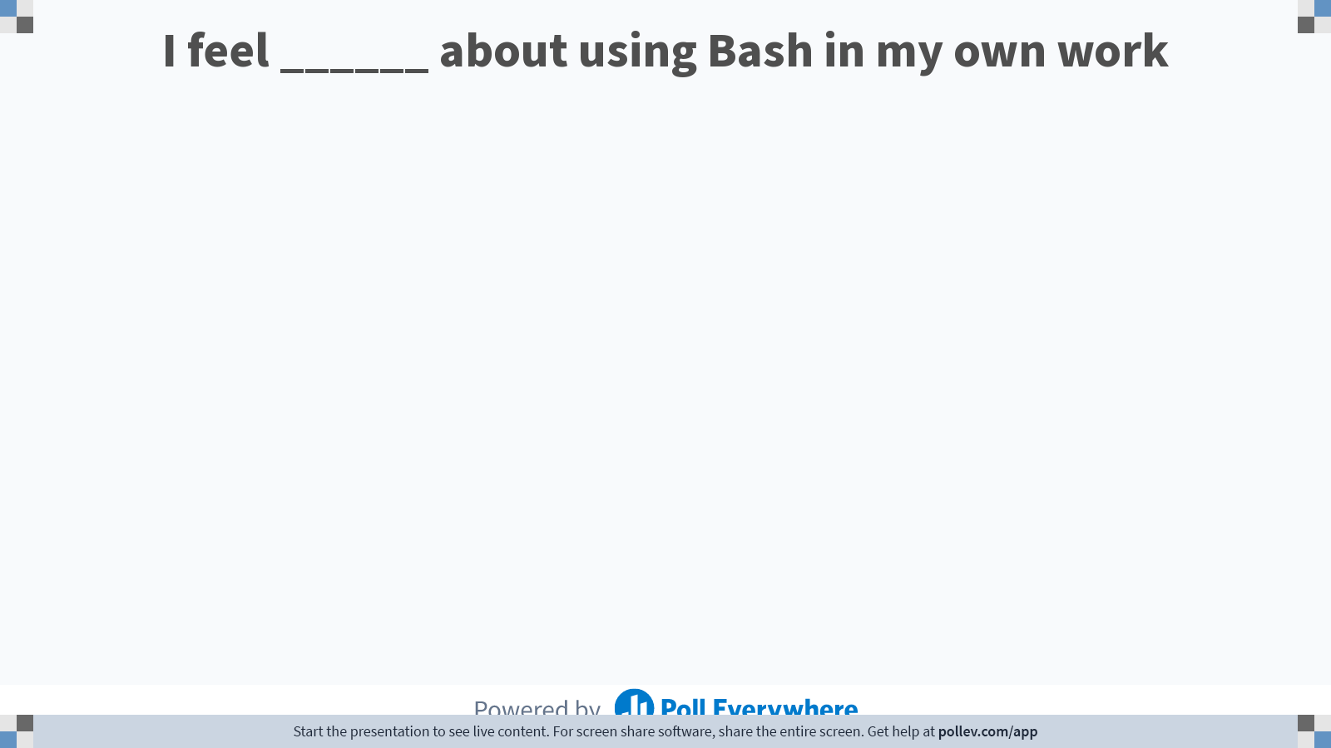
Notes:
Do not modify the notes in this section to avoid tampering with the Poll Everywhere activity. More info at polleverywhere.com/support I feel ______ about using Bash in my own work
https://www.polleverywhere.com/free_text_polls/oCSRvPwOGE1O6ciqcYEjQ

Slide 18
Computing on a Cluster
A computer cluster is a set of loosely or tightly connected computers (nodes) that work together so that, in many respects, they can be viewed as a single system.
https://en.wikipedia.org/wiki/Computer_cluster
Notes:
https://www.breeze-software.com/services/high-speed-modeling/cluster-computing/
get vs. put

Slide 19
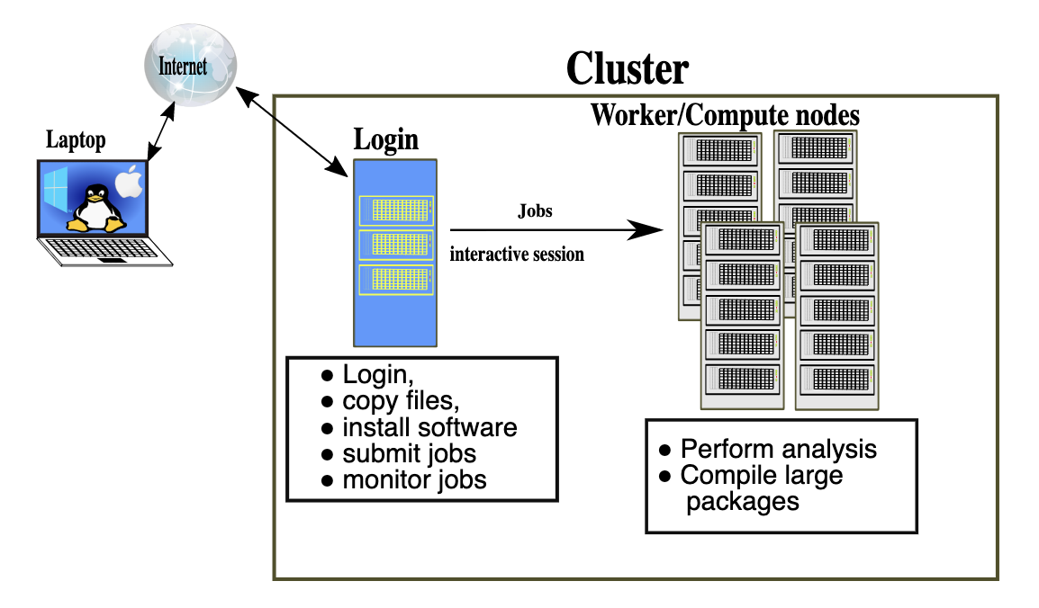
Working locally vs remotely
https://sabryr.github.io/hpc-intro/12-cluster/index.html

Slide 20
Try it yourself: Log onto the Duke Compute Cluster (DCC)
ssh YOUR_NETID@dcc-login.oit.duke.edu
& look around!
Instructions can be found here: https://dcc.duke.edu/dcc/login/

Slide 21
DCC Demo – Part 1
Connecting to and looking around the DCC

Slide 22
What is Shell Scripting?
Like writing a script in any computing language (R, Python, Matlab, etc.)
Combining a set of commands into a single text-based file, rather than typing each one individually into a command line / console
The shell executes the commands in the text file just like you had typed them in.
https://www.amazon.com/Classic-Shell-Scripting-Arnold-Robbins/dp/0596005954/ref=pd_bxgy_img_3/147-2925148-0357648?_encoding=UTF8&pd_rd_i=0596005954&pd_rd_r=bd3931c2-3d43-4fc3-9392-d93555de74bb&pd_rd_w=dtd8I&pd_rd_wg=dQHHg&pf_rd_p=09627863-9889-4290-b90a-5e9f86682449&pf_rd_r=1QN2XXTTAW6YPAQCFPW7&psc=1&refRID=1QN2XXTTAW6YPAQCFPW7
https://www.quora.com/What-is-the-difference-between-UNIX-Linux-Bash-Zsh-shell-programming-and-shell-scripting-What-is-meant-by-the-word-shell

Slide 23
Shell Scripting
shebang
#!/bin/bash # example of using arguments to a script echo "My first name is $1" echo "My last name is $2" echo "Total number of arguments is $#"
Save this file as name.sh, set execute permission on that file by typing chmod a+x name.sh and then execute the file like this: ./name.sh.
$ chmod a+x name.sh
$ ./name.sh Hans-Wolfgang Loidl
https://www.macs.hw.ac.uk/~hwloidl/Courses/LinuxIntro/x945.html

Slide 24
DCC Demo – Part 2
Shell Scripting

Slide 25
DCC Demo – Part 3
Submitting jobs to the cluster

Slide 26
put, get, wget
Put, get:
Moving files to and from the cluster from your local drive
Wget, curl
Downloading files from the internet to a remote server (e.g. the cluster)

Slide 27
DCC Demo – Part 4
Moving files between the cluster and your local machine

Slide 28
Github
Recall that we use version control and code sharing software to support reproducible data science!

Slide 29
What is GitHub?
GitHub is an open-source repository hosting service for code.
Variety of different programming languages
Keeps track of the various changes made to every iteration by using git, a revision control system that runs in the command line interface
Notes:
Source: https://www.thebalancecareers.com/what-is-github-and-why-should-i-use-it-2071946

Slide 30
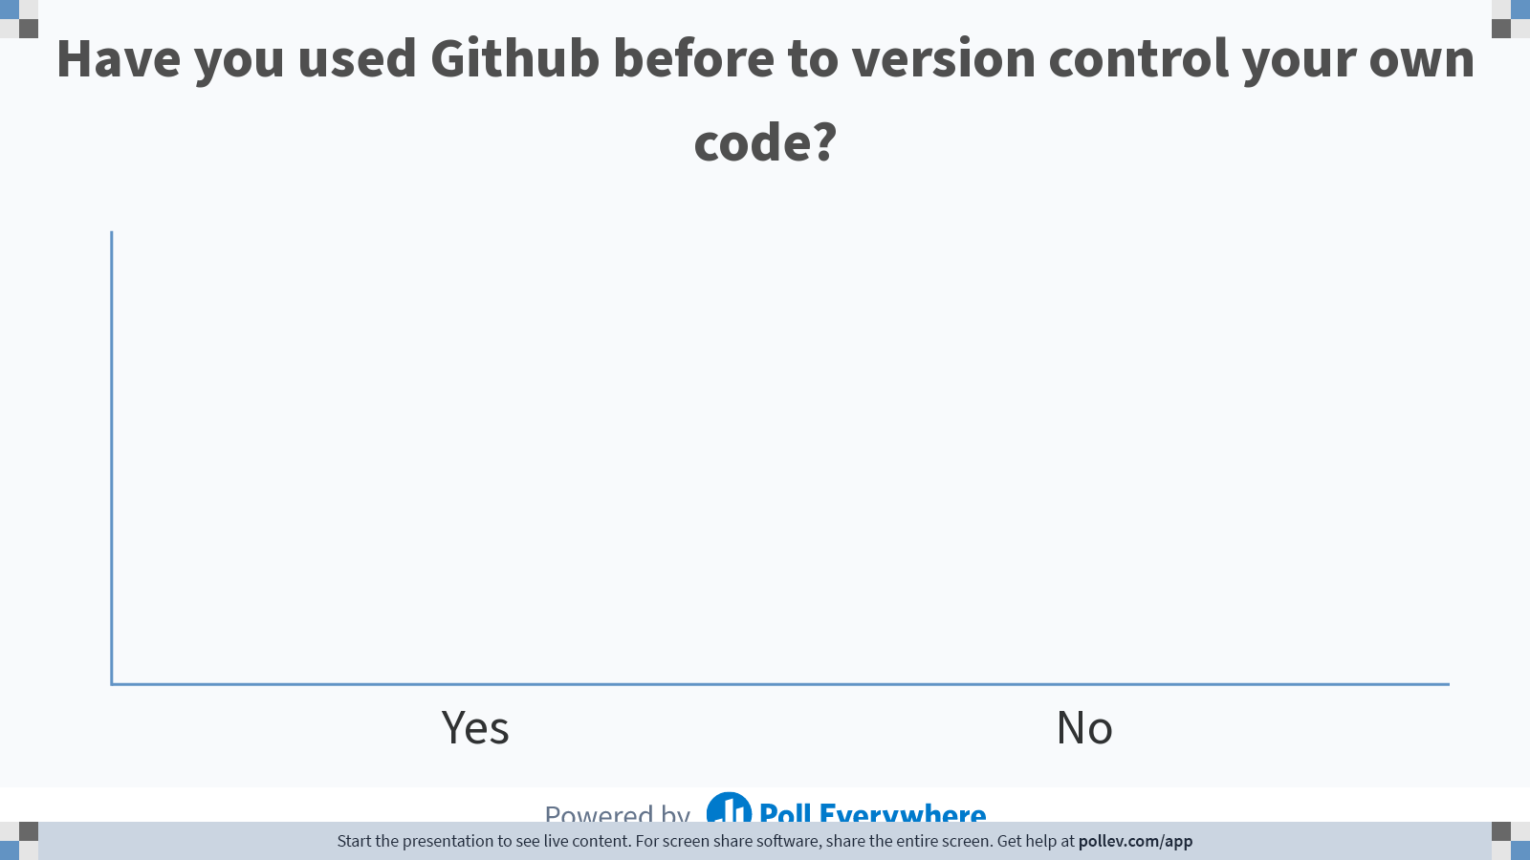
Notes:
Do not modify the notes in this section to avoid tampering with the Poll Everywhere activity. More info at polleverywhere.com/support Have you used Github before to version control your own code?
https://www.polleverywhere.com/multiple_choice_polls/ElBqTIzb6xVxC5LxLnB7D

Slide 31
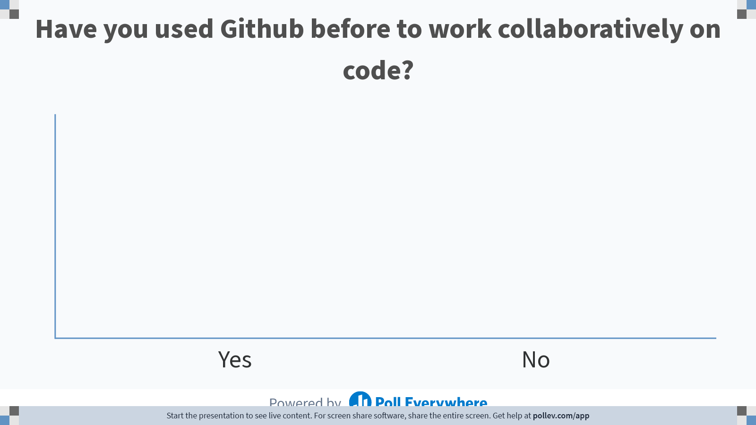
Notes:
Do not modify the notes in this section to avoid tampering with the Poll Everywhere activity. More info at polleverywhere.com/support Have you used Github before to work collaboratively on code?
https://www.polleverywhere.com/multiple_choice_polls/9qtv6zls09b0ZX3qtm4rP

Slide 32
Why should I be using GitHub?
> 28 million users- huge network!
Allows for easy collaborations
Trackable
Enables you to become active in the community
Improve your attractiveness as a job candidate (a public portfolio of your work as a data scientist!)
~1GB/repository (file <50-100MB)

Slide 33
Two Scenarios for Using Git
you want to track your own project
you want to start working on someone else’s project

Slide 34
Where we organize what we want to commit to our repository
https://github.com/fedosejev/front-end-course/blob/master/week-01/day-01/learn-git.md

Slide 35
Git Commands
git config --global [user.name] [user.email]
init
status
add [-filename] [-A]
reset [-filename]
Commit -m
log

Slide 36
Cloning a remote repo
clone <url> <local place to clone>
remote –v
branch –a
diff
push [origin master]
pull
Try cloning the repository at https://github.com/jessilyn/BME590_practice
Add your name to the readme file

Slide 37
Reminders & Upcoming Deadlines
Homework #1 is due Thursday (1/26/2023)
If you have questions about the homework, please reach out to your TA first
Quiz #1 is next Tuesday (1/31/2022) during class
Your project groups are due the following Thursday (2/2/2023)
Please reach out to me if you are having trouble finding a group

